Slide 1
337 Semester Project
By: Anthony Rocha

Slide 2
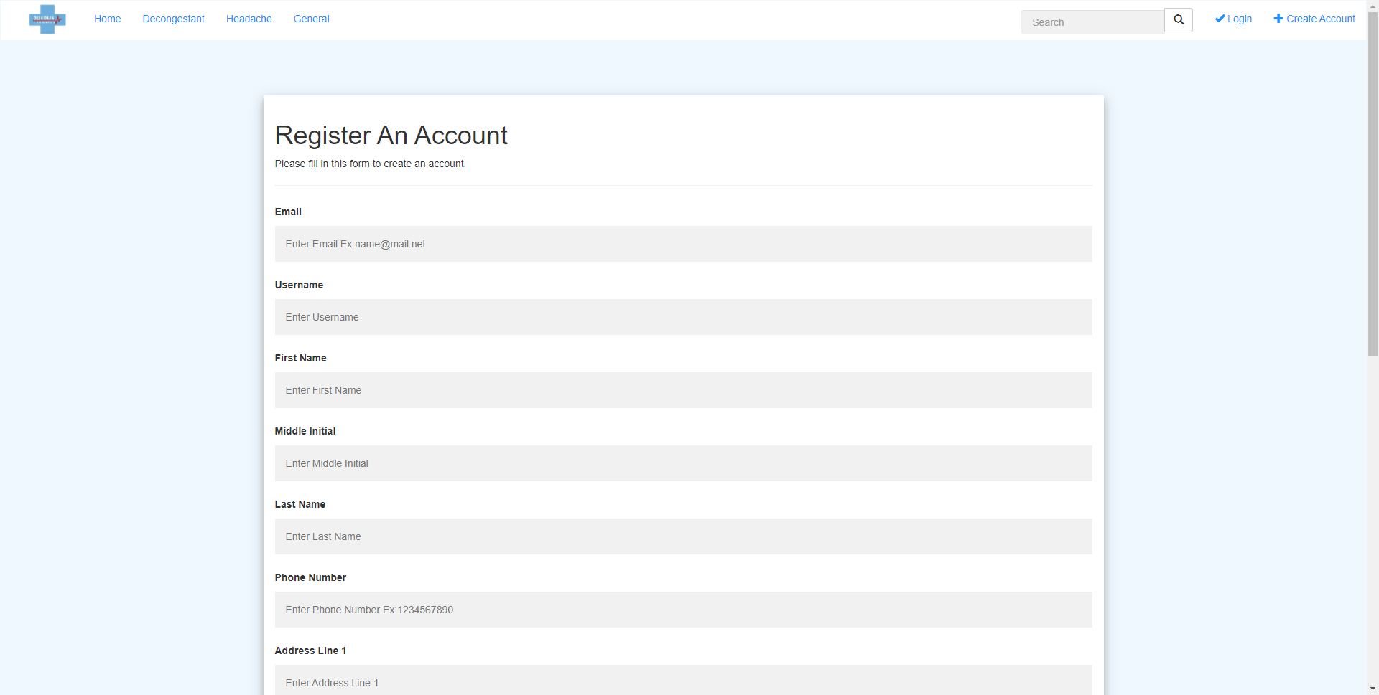
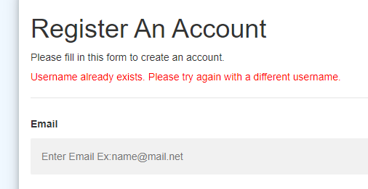
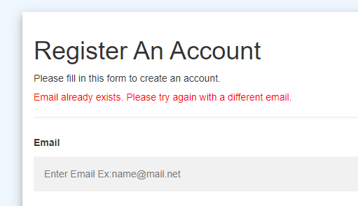
Create Account
If you do not have an account you can create one and use those credentials to login and make purchases on the website. All data must be filled out in the form (except Address Line 2 is optional). When you click “Register”, your password is hashed using the opassword_hash function. The username and email are checked against the database to see if they are already registered, if they are then you are shown an error message that the username already exists or that the email already exists. If they don’t exist then the username, hashed password, and email are inserted into the users table. The other information about the address is inserted into the address table.

Slide 3
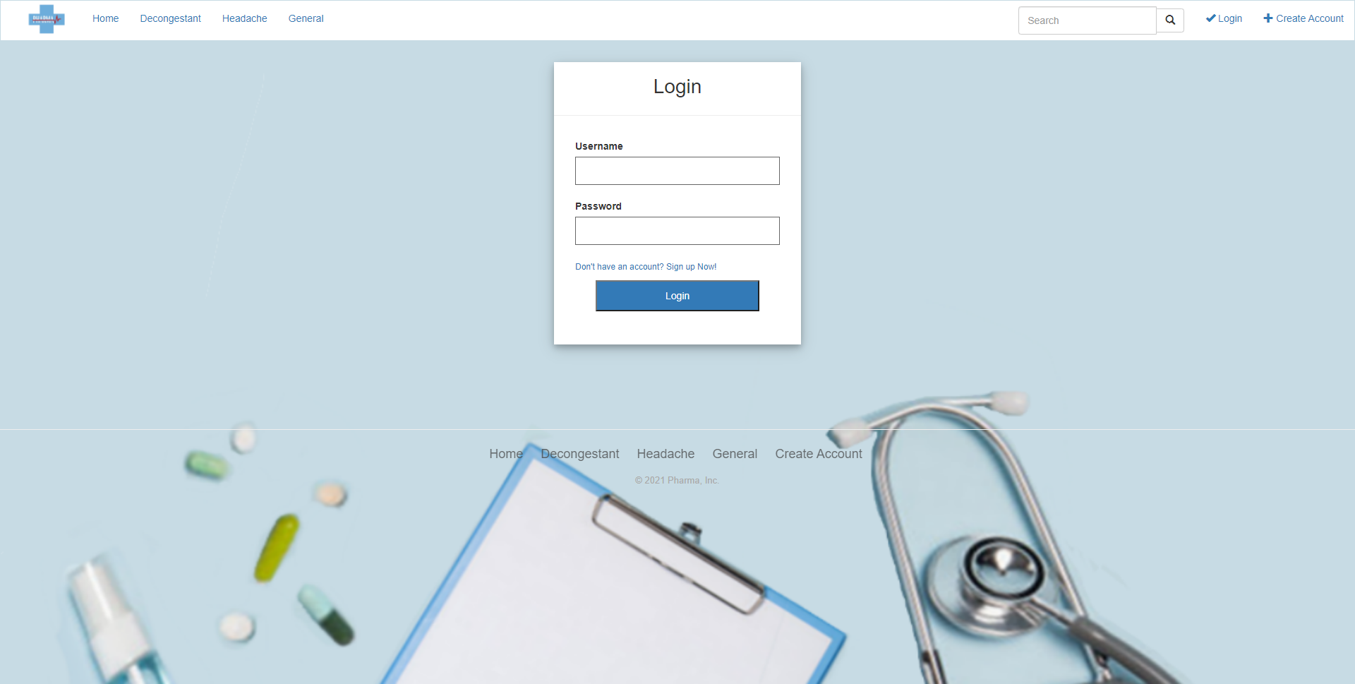
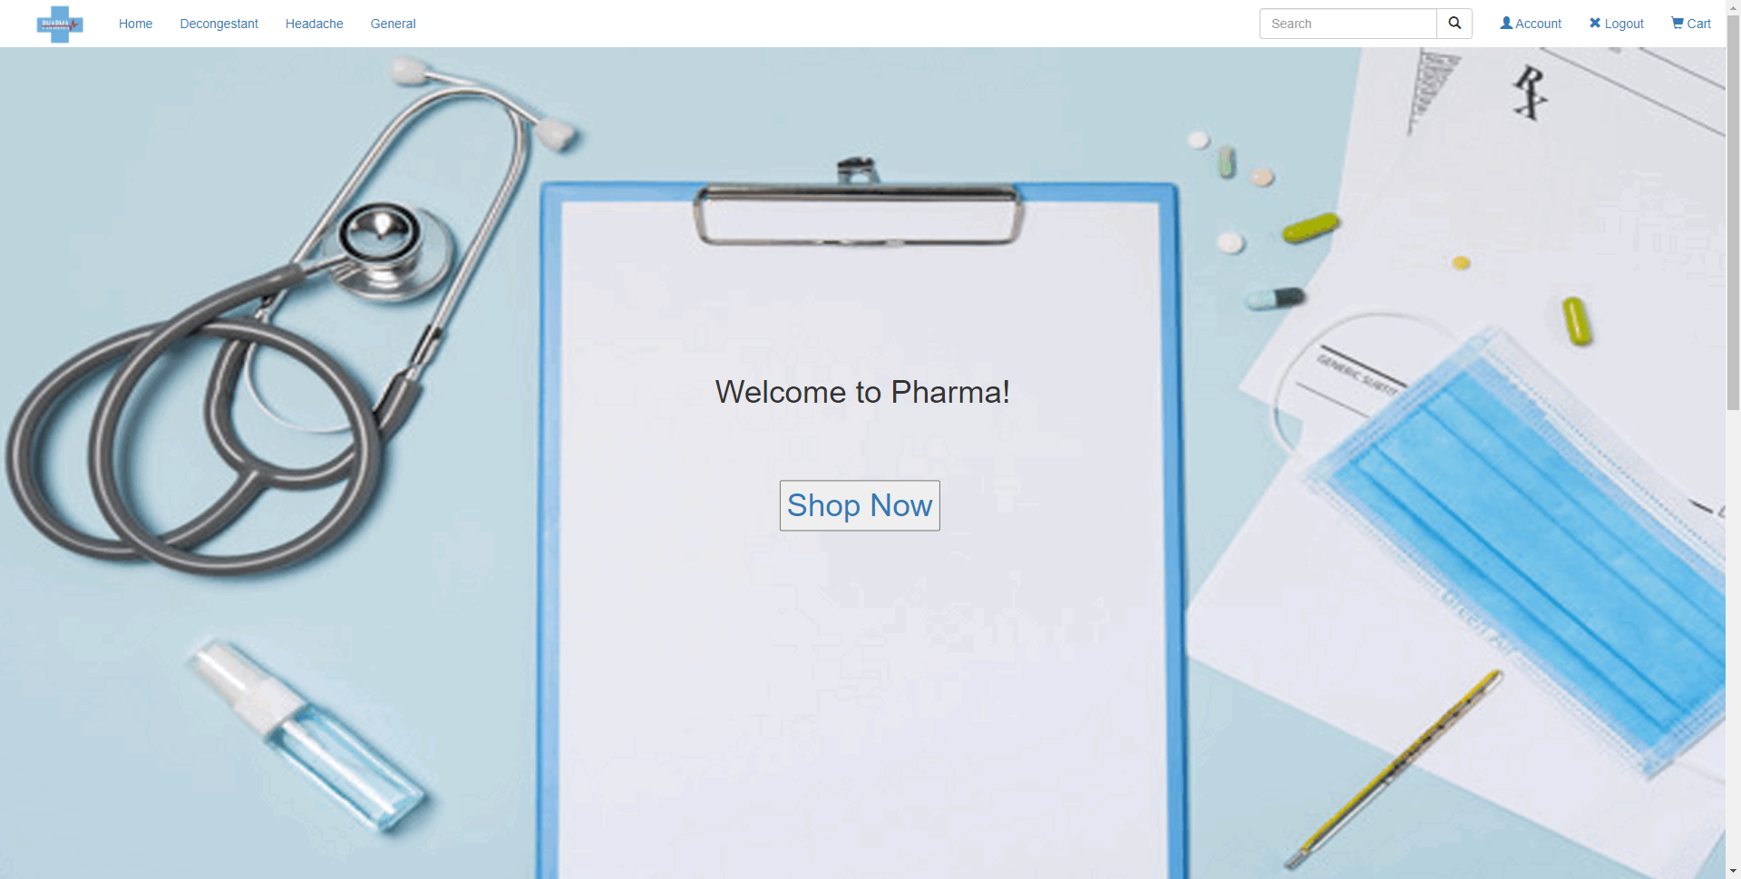
Login
Admin Login: Special account type, found in the database, that signifies the account is an “Admin” account. Has special privileges and access to the managerial components on the website. Otherwise it is the same as a normal customer account.
Non-Admin (“Normal” customer) Login: Can add products to your cart and view your total you are going to spend on an order. Can place orders once shipping address and payment info are added. In your account page, you can see all your past orders and, if it is within an hour, you may cancel an order.
The login component is implemented by a form which asks the user for the username and password. When the form is submitted, the username and password are checked against the database to verify the account exists. The password first has to be unhashed as it is stored hashed in the database. Each user also has an assigned user_type which determines whether the account belongs to an administrator or a customer. The user is then sent to the homepage and displays the appropriate header for the account type. The administrator header has access to the admin privileges.

Slide 4
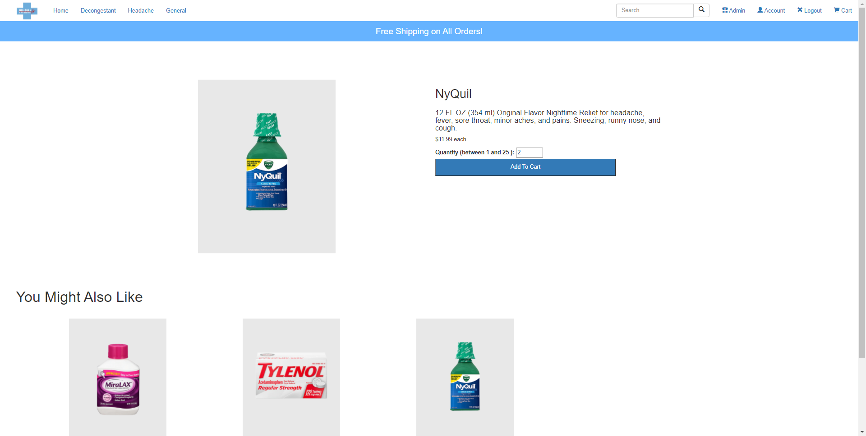
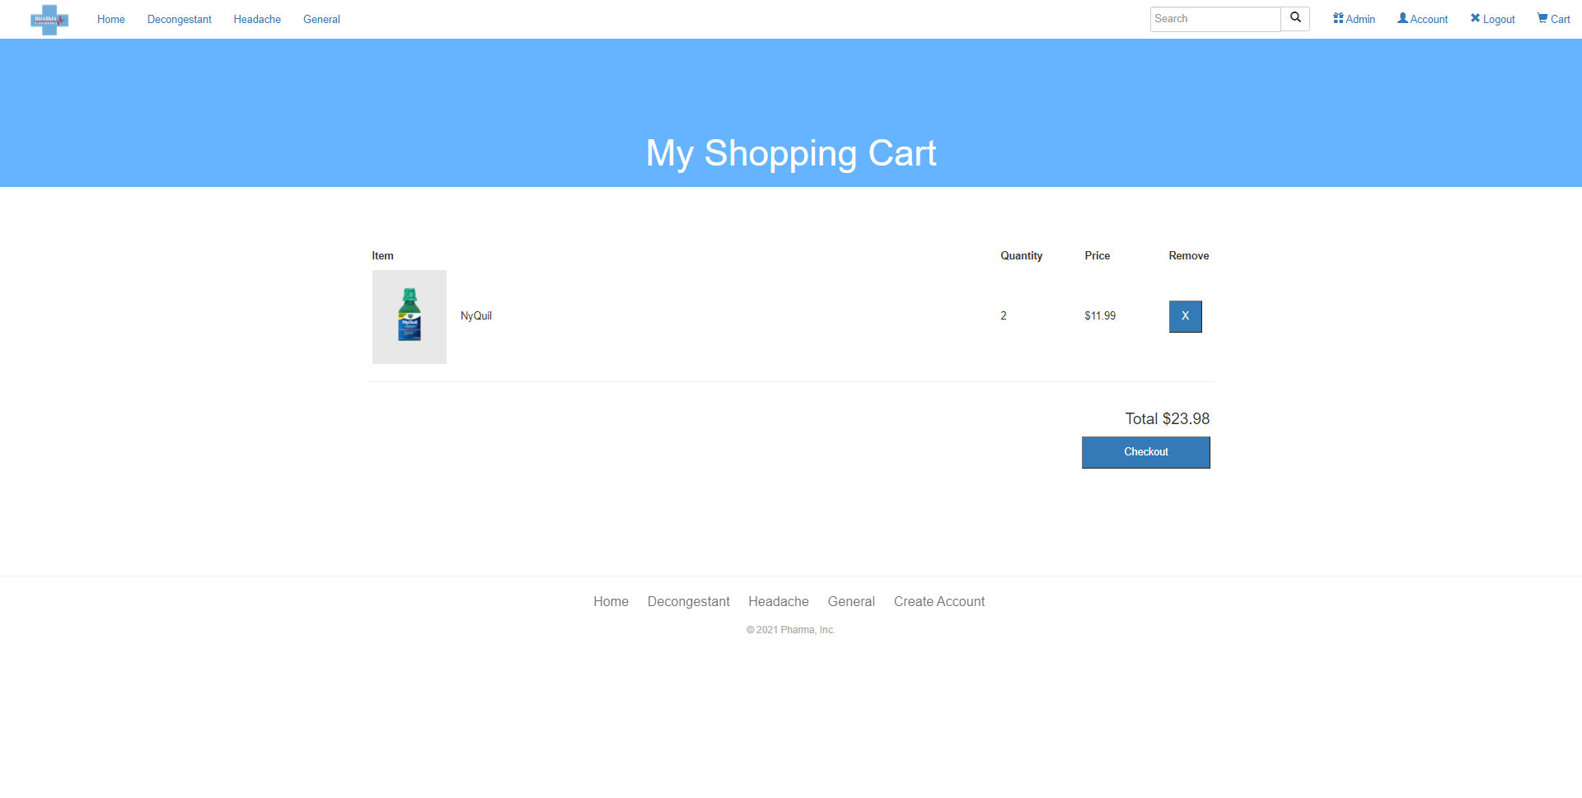
Add to cart
Add to Cart: When on a product page, you can add as many to your cart as you want as long as it does not go over the maximum there is available for purchase. When the product pages are loaded, the database is checked for the stock amounts and sets the maximum quantity allowed to be added to the cart to the maximum amount available in the system. Once items are selected and the add to cart button is clicked, the item's product ID, the user ID and quantity added is used to create a new entry in the shopping cart table of the database.

Slide 5
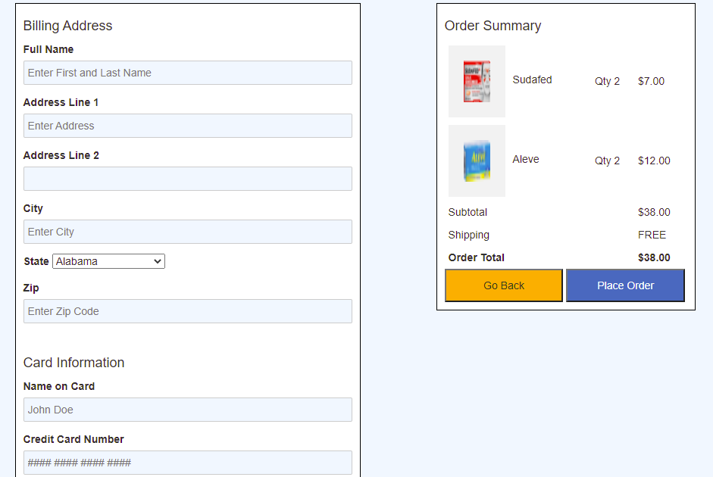
Payment
When all payment and shipping info are entered. All order information is added to the database and is tied to your account so you may view it at a later time. Card number must be numbers and spaces with a length of between 13 and 19. Card cvv must be numbers of length 3.

Slide 6
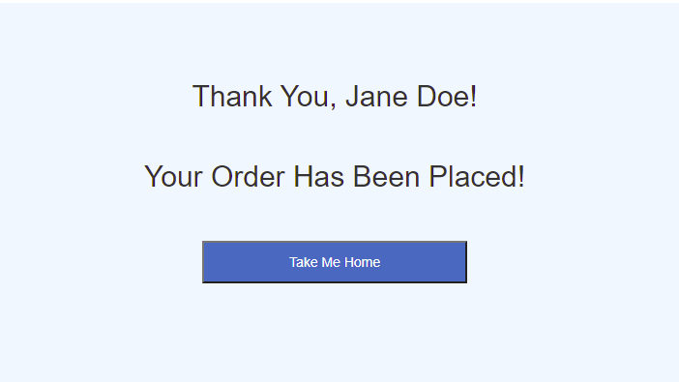
Order Placed

Slide 7
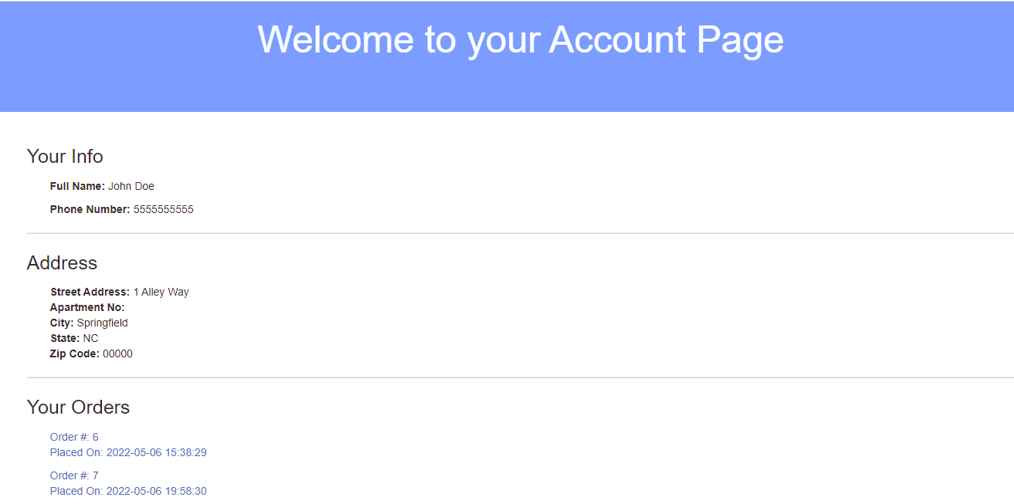
View Order and Account Details
In your account page, you can view all of the account details and any past orders are shown via order number. This is implemented by selecting account information from the user and address table using the session user ID as reference.You may click on one of the orders to view its details. Order details contain what product(s) were bought in that order, total price per item, the total price of the order, order date, and current status of the order. All information is laid out using the order ID in the sql statement.

Slide 8
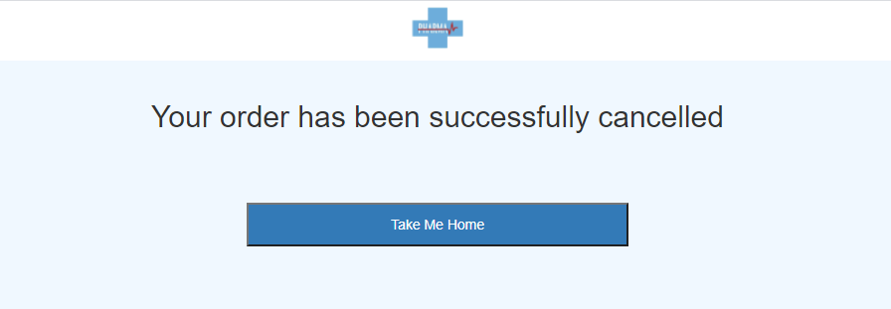
Cancel Order
For the cancel order requirement, it is programmed so that the customer can cancel the order within the first hour of their purchase. The cancellation button will only show when the status of the order is ready and will not show when it changes to shipped, delivered, or cancelled.
The order status can also be changed by an admin in the admin portal. The status of the order can only be changed after one hour passes when the order was made. If they try to change it before that hour, they will get an error message telling them to wait.

Slide 9
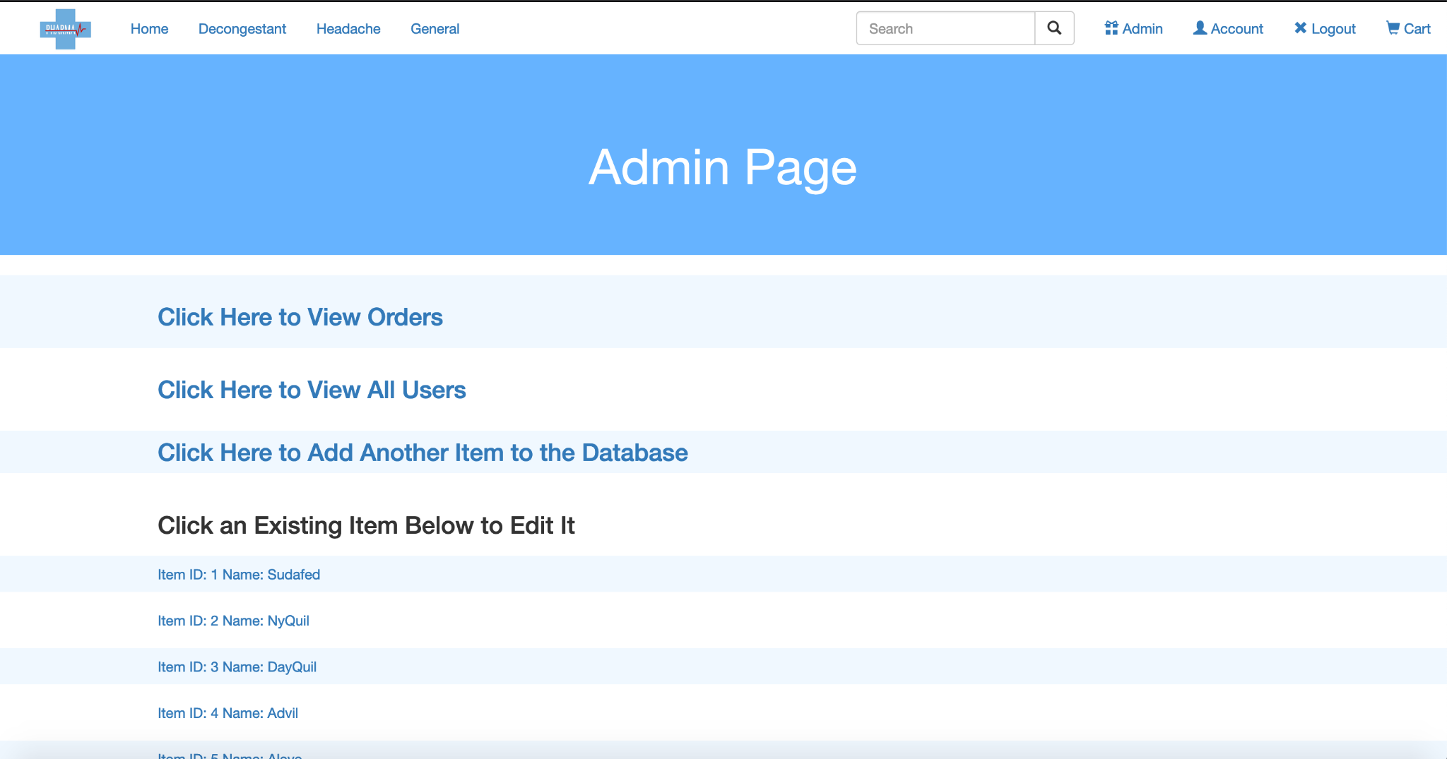
Admin View
Administrator accounts have access to a special admin page which provides the option of viewing orders, editing order statuses, viewing users, adding products, deleting products, and editing products.

Slide 10
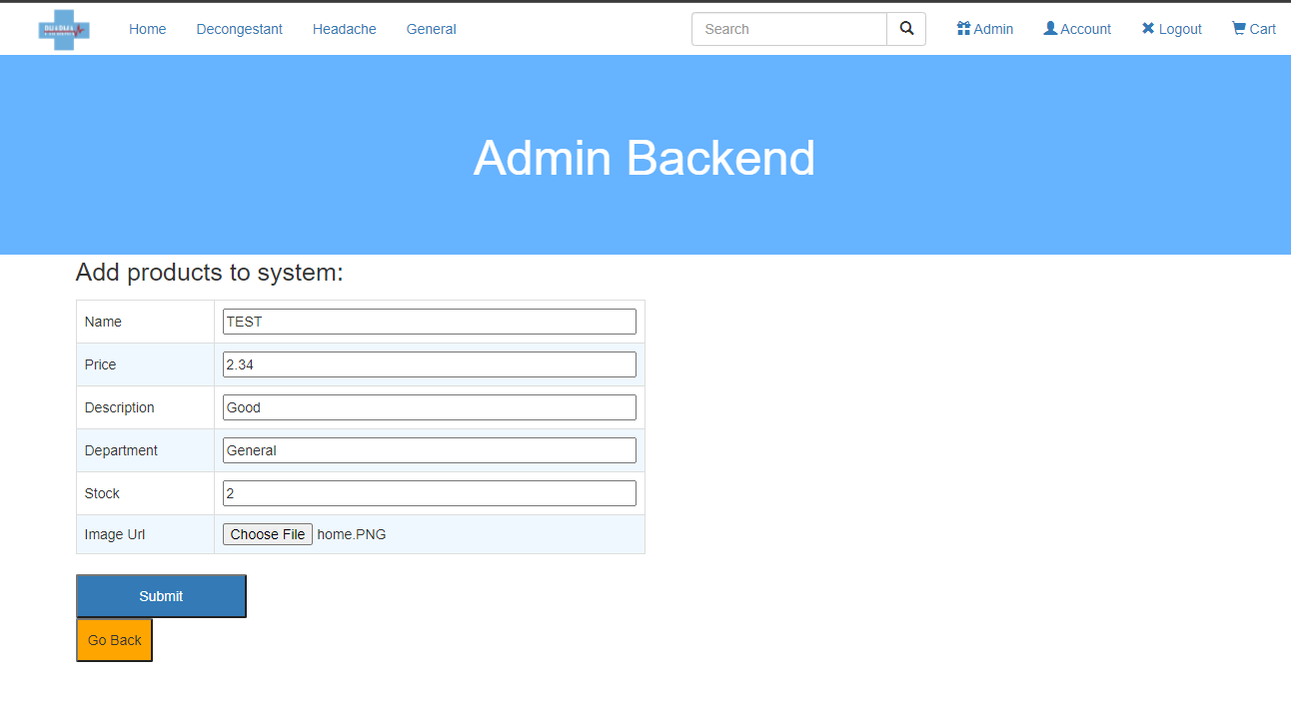
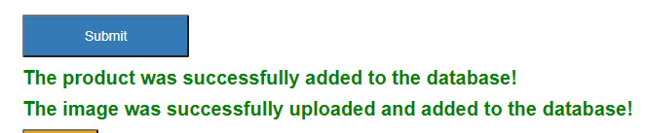
Admin Add Product
This action can only be completed by an administrator account. All fields must be completed to add another item to the database.
This component was implemented by creating a form which takes all the relevant info and passes it to an add sql statement which fills the item in the database.

Slide 11
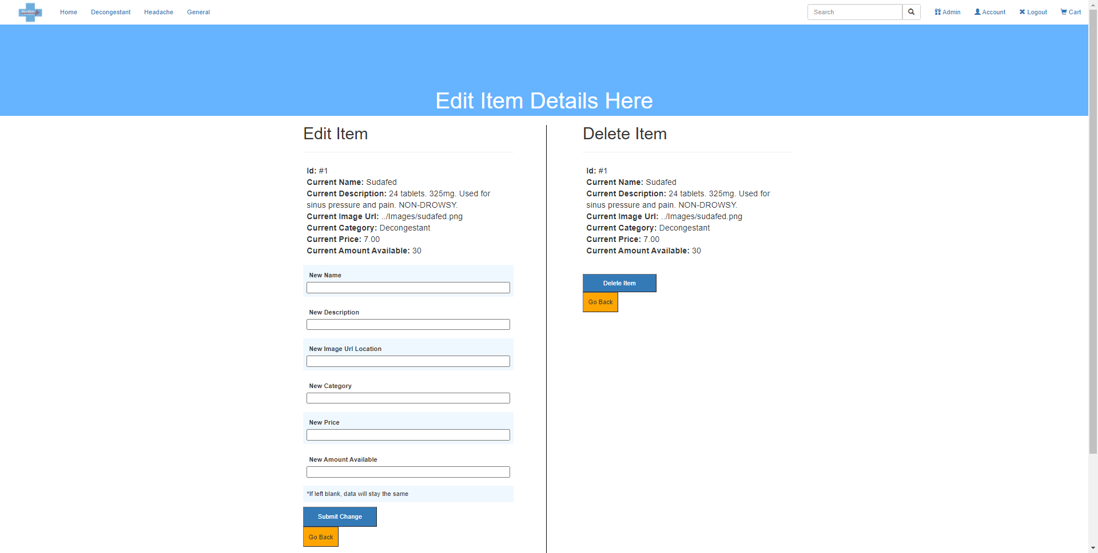
Admin Edit Product
Existing items can be edited with a new name, description, image url, category, price, and/or amount available. This is accomplished with a form. The form is set so that it does not need to be filled out fully. The admin can choose specifically what aspect is to be changed. The code senses what part of the form has been filled out and generates an appropriate set sql statement.

Slide 12
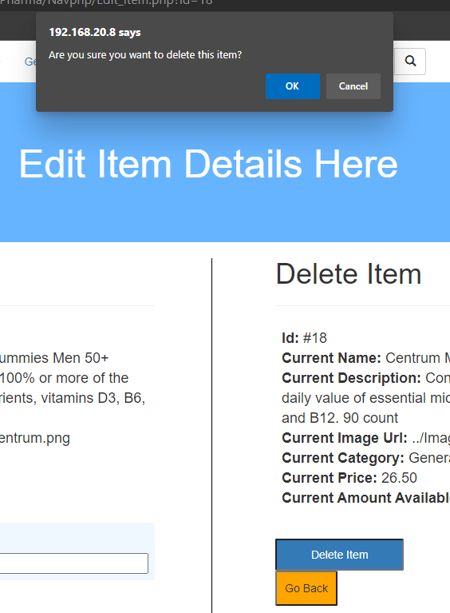
Admin Delete Product
An admin can choose to delete an item from the database as well. When an admin tries to delete an item, a confirmation box pops up so that it is difficult to accidentally delete a product. This task is accomplished by a delete sql statement which uses the product ID. The ID that is used is assigned when the admin clicks on an item from the admin page.

Slide 13
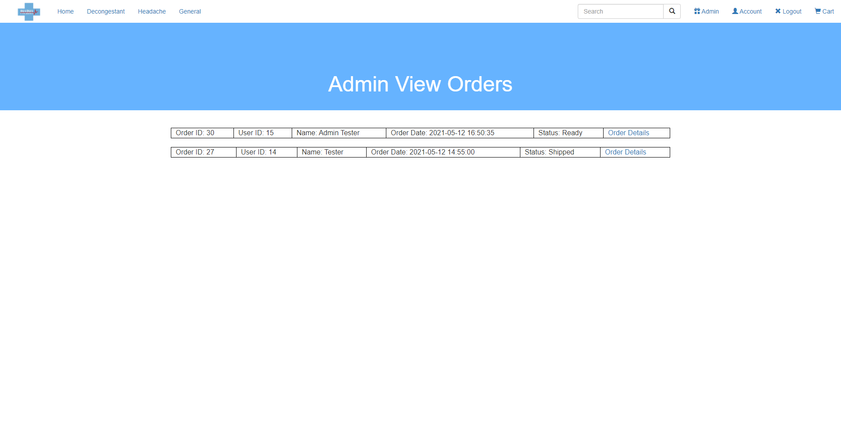
Admin View Orders
Can see all orders in the system. When clicking on a specific order, the admin can see details about it and change the status of the order. If the admin tries to change the status to cancelled within an hour of the order being placed, it will not go through as the customer has an hour to cancel the order on their end first. After an hour, the admin can cancel the order from this page. All orders from the orders table of the database are listed using a select sql statement with the order IDs, user IDs, User names, order dates, and order statuses. The results are then sent to a table.

Slide 14
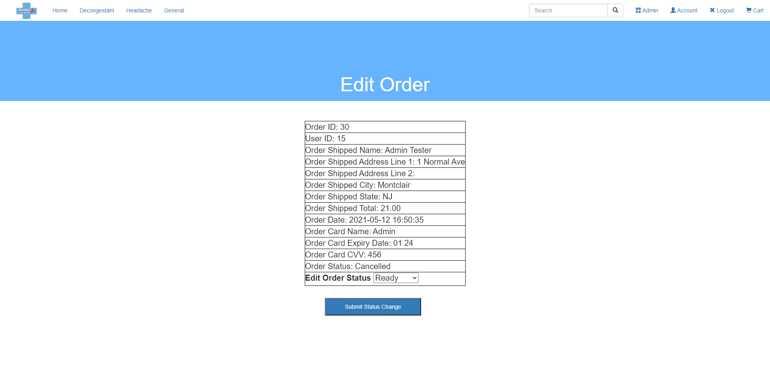
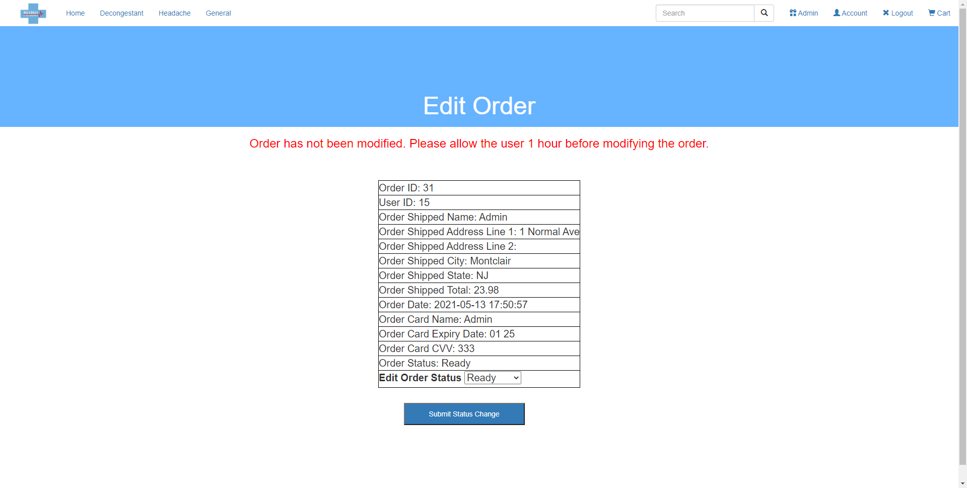
Admin Process Order
Administrators can select specific orders to edit. They will be able to change the status of the order from a dropdown menu (ready/shipped/delivered/cancelled). When “Submit status change” is clicked, a set sql statement is created using the orderID which changes the status in the database. An admin can modify order status starting an hour after the order is created. Same as Cancel Order, using the TIMEDIFF() function, we check the order date from the database of the order we want to modify. We create a new timestamp when we want to change the status and check to see if the hour is less than 1 (under an hour between order placed and current time).

Slide 15
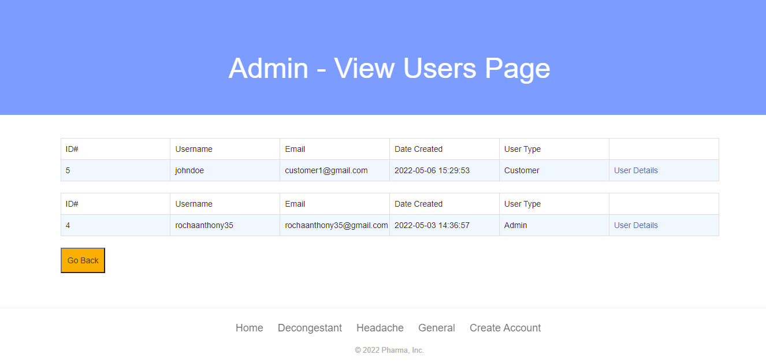
Admin View All Users
Admin can see the user id, username, email, date created, user type and can click a button to check their user details. This is done using two pages where the first page displays the user’s id, username, email, date created, and user type. This is done by selecting the id, username, email, date created, and user type from the user table. Then this is stored in an array where each item can be echoed out to the table. The last entry in the table is the “User Details” which links to the user detail page. On this page, the id is carried over from the user details reference and used to select the user’s information from the address table based on the id of that user. The information is stored in another array and then that is used to echo the information into the table. Here the admin can see the user’s full name and their address.

Slide 16
Interface Requirements
Front-end software: HTML, CSS, Bootstrap
Back-end software: MYSQL, PHP, Apache
OS: Windows

